Slide 1
Which class represents the sentiment of tweets on Twitter?
Beckett Schultz

Slide 2
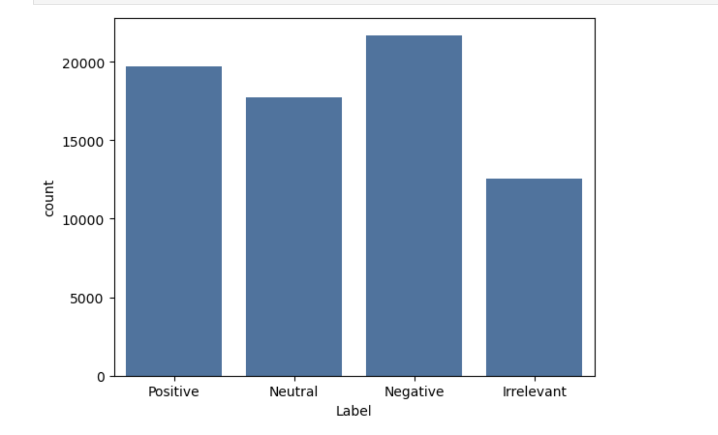
The negative label has the highest occurrence among our data.
Histogram with all four classes
Only label with over 20,000 instances

Slide 3
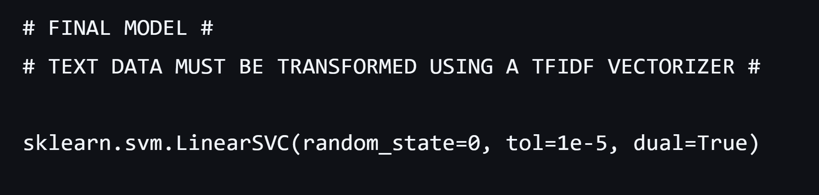
Building of predictive model leads to strong results.
Model metrics text file containing best model
Improvements needed to handle more complex data

Slide 4
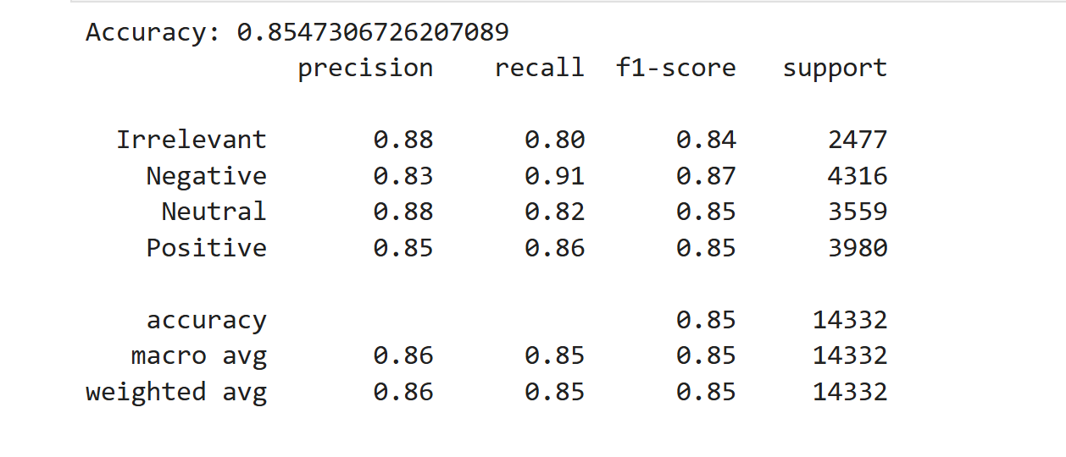
Linear Support Vector Machine handled the linearly separable text data the best.
LinearSVC from scikit-learn
Text data transformed with TfidfVectorizer

Slide 5
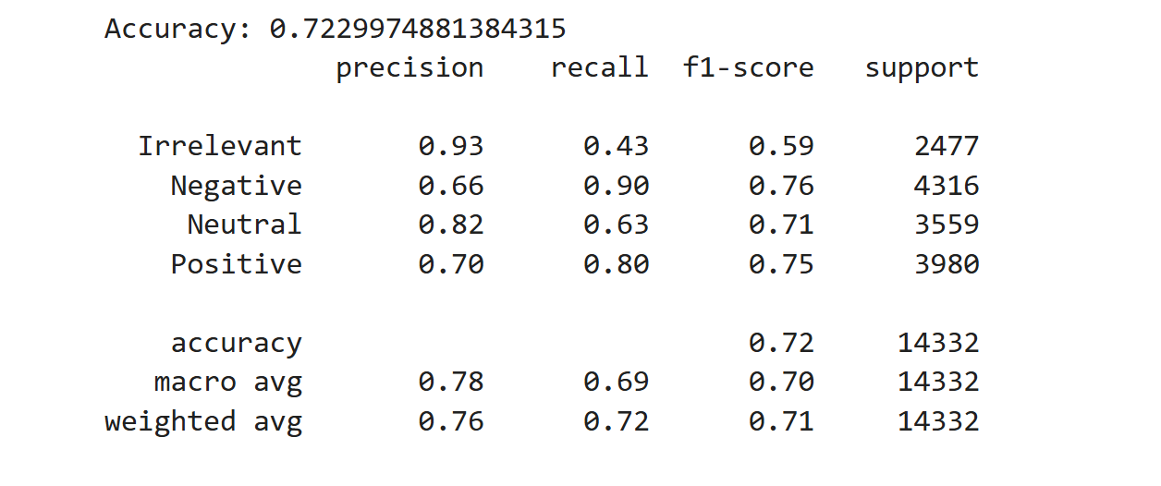
Multinomial Naive Bayes model was a good starting point, but did not meet performance needs.
Multinomial ideal when there is more than two possible outcomes
Lower accuracy

Slide 6

Other models explored, but no discoveries were made.
Logistic Regression
Random Forest Classifier (memory constraint)

Slide 7
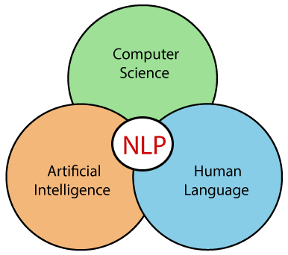
Natural Language Processing (NLP) is becoming increasingly popular.
Tokens
Count Vectorizer (Bag of words)
Tfidf Transformer

Slide 8

Data Wrangling was fairly straight forward.
Information gathered from Kaggle
Dataset initially selected because of cleanliness
Missing and duplicate values dropped

Slide 9

Preprocessing was performed to ensure efficiency during model building phase.
HTML remover (BeautifulSoup)
Regular expressions
80/20 Train Test split

Slide 10

Insights gained from NLP could have lasting effects.
Aid in determining sentiment towards company
Avoid high cost of surveys through social media APIs

